Slide 1
Progress Report
陳柏志
2021/03/17

Slide 2
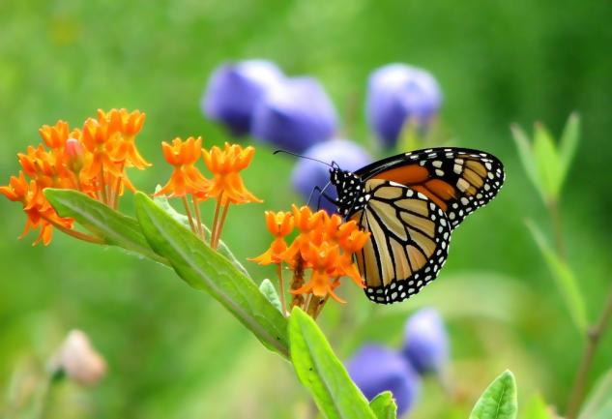
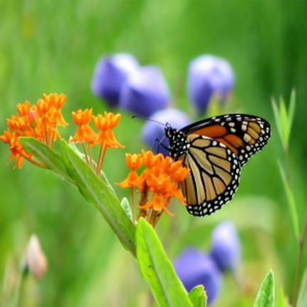
Patch-based image Warping for Content-Aware Retargeting

Slide 3
Environment
C++
OpenCV 3.4.13
Cplex

